Slide 1
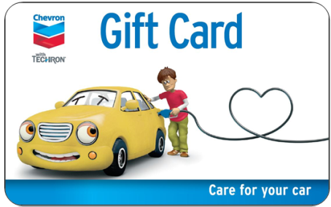
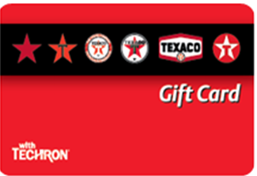
marketers - promote gift card sales to your retailers!
2016 Opportunity: Sales East – 77% of Stations didn’t Sell our Gift Card
2017 Opportunity: Sales East YTD 86% of Stations haven’t Sold our Gift Card
What’s in it for your Retailers?
• Increase in Incremental Gallons
• Increases Marketplace Share
• Helps Drive New Sales
• Brand Loyalty from Existing Customers
.
• Prevent a Shift in Brand Loyalty
• Gift Cards have been the #1 Most Popular Gift
for the past 10 years
• No Transaction Fees on Gift Cards
• Sales can be Limited to Cash & Debit Purchases Only to Avoid Credit Card Transaction Fees
Getting Started is Easy & Free!
Retailers Can Order the Following at No Cost to Them
Starter Kits Including:
Gift Card POP
Gift Card Plastic Displays
Gift Card Procedure Guide
Gift Cards & Envelopes in Bulk
All of the Above Can be Shipped to the Marketer for
Distribution or Straight to the Retailers
To Order, Contact our Gift Card Coordinator, Kathy Rantz:
925-842-9519
kathy.rantz@chevron.com
Notes:
Talking Points
1) Increase sales - In addition to simply increasing sales/profits with incremental customers, gift cards help generate additional [non-gift card] revenue through overspend.
2) Become the “go-to” place for fuel supplier gift cards over our competitors.
3) Help Drive New Sales – Reach new customers for your stations.
4) Brand Loyalty from Existing Customers – Gift cards are reloadable which helps promote customer loyalty.
5) Prevent a Potential Shift in Brand Loyalty to our Competitors – If customers get a gift card for one of our competitors, there is a chance they will shift loyalty from Chevron and Texaco to a competitor.
6) Gift Cards are Popular - Gift cards have been the #1 requested gift for the past nine straight years.
7) Keep our Customers Loyal - If a gift card is not available at a station, people will likely go to one of our competitors and purchase one of their gift cards.

Slide 2
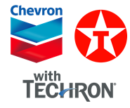
new in 2017 – call to action for marketers
What’s New in 2017?
New Refreshed Gift Card POP (coming in Q3)
Refreshed Gift Cards
New Chevron Gift Card Design
New Texaco Gift Card Design
Rolling Out a New Dual-Branded Gift Card for Texaco Stations
Auto-Shipments of Starter Kits & Gift Cards with Envelopes to all new Stations
Marketers can have their network Auto-Shipped in Bulk for Marketer Distribution
Call to Action for Marketers
Marketers:
Follow the Instructions on how to Place Bulk Orders for Gift Cards & Starter Kits on Slide #1
Encourage your Retailers to Promote Gift Card Sales at their Stations & Ensure Gift Card Displays with Gift Cards & Envelopes are Placed near the Cash Register
For Questions, Contact Kathy Rantz at 925-842-9519 or kathy.rantz@chevron.com
Cost is Free!!!

